Slide 1



Your IT Transformation Partner
Version : 1.5 Last Updated on : 1st January 2018
MWX – Online Property Management – Screen Flow v1.1
1

Slide 2
Online Property Management System – Feature List

Slide 3
FRONTEND MODULES
2

Slide 4
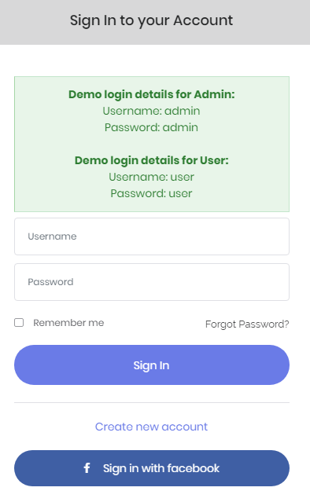
Sign in

Slide 5
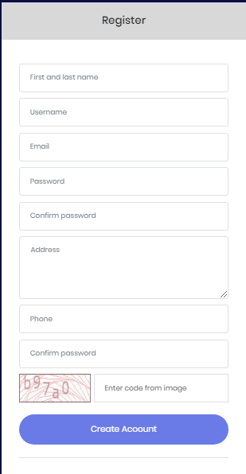
Register

Slide 6
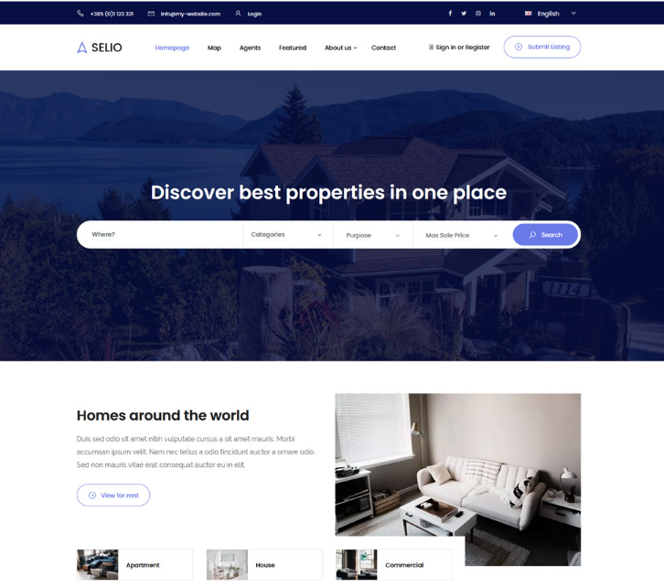
Home Page
6

Slide 7
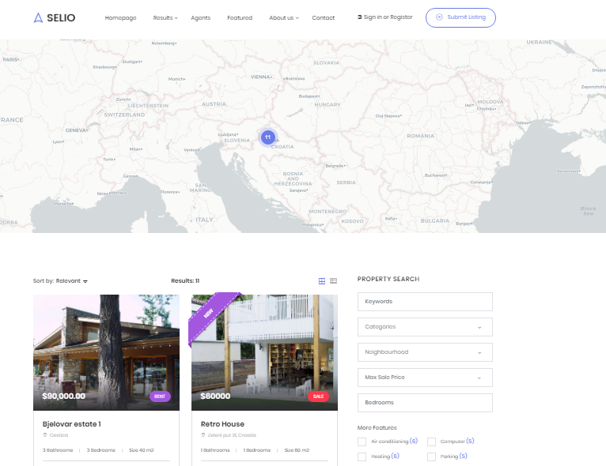
Mapping
7

Slide 8
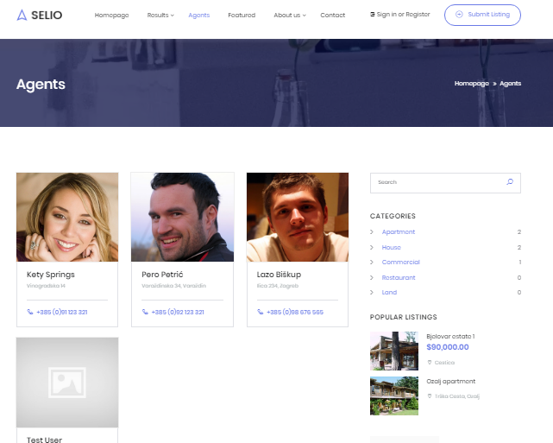
Agents
8

Slide 9
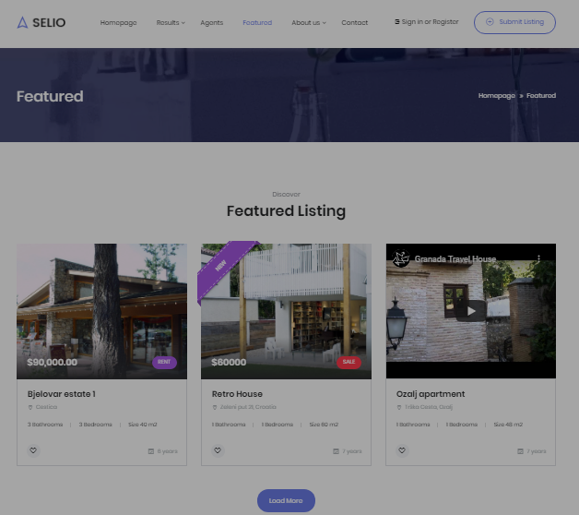
Featured

Slide 10
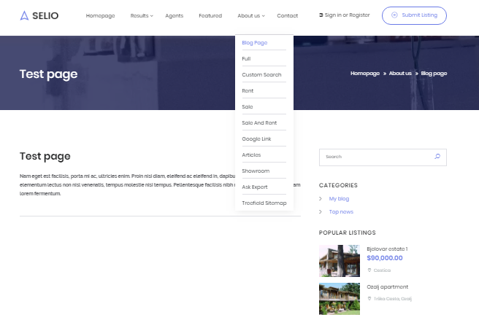
About us

Slide 11
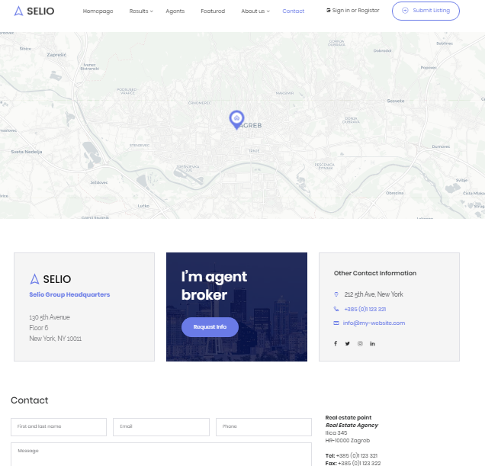
Contact

Slide 12
BACKEND MODULES

Slide 13
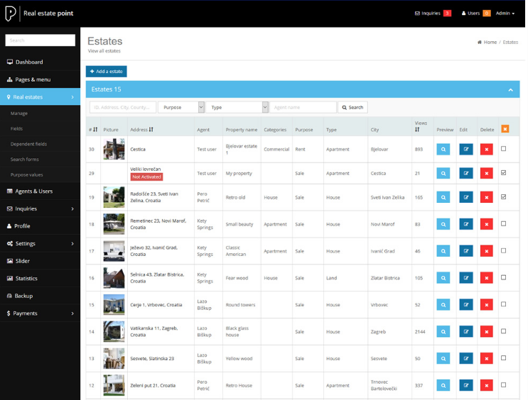
Real Estate

Slide 14
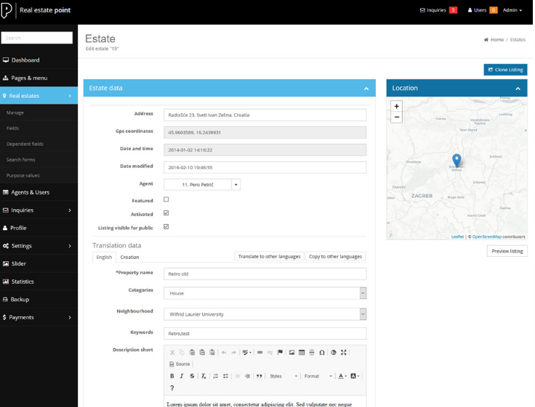

Slide 15
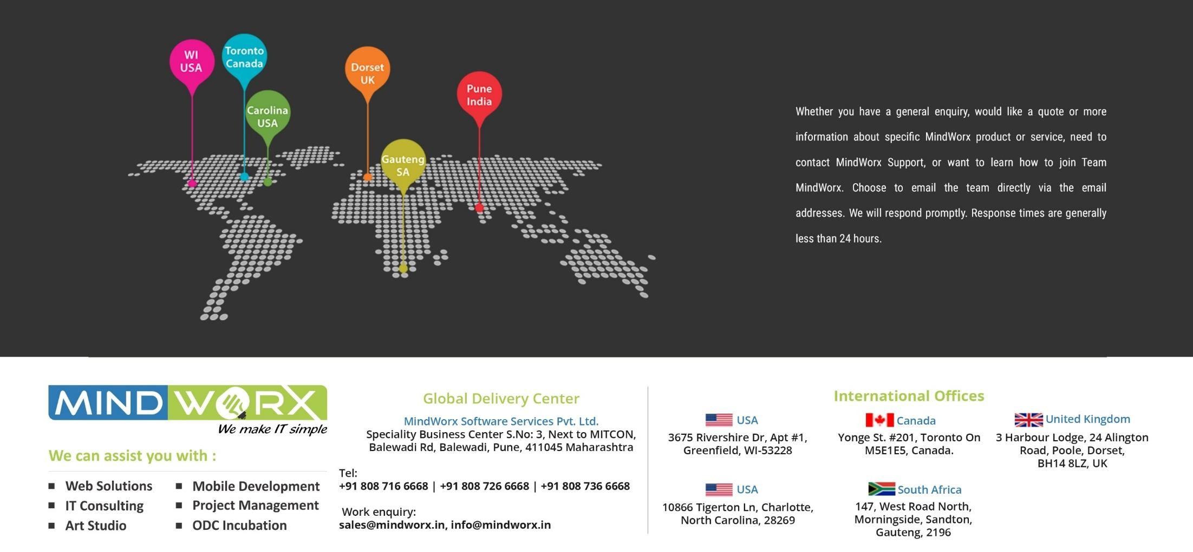
Thank You
28

